Slide 1
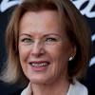


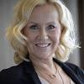
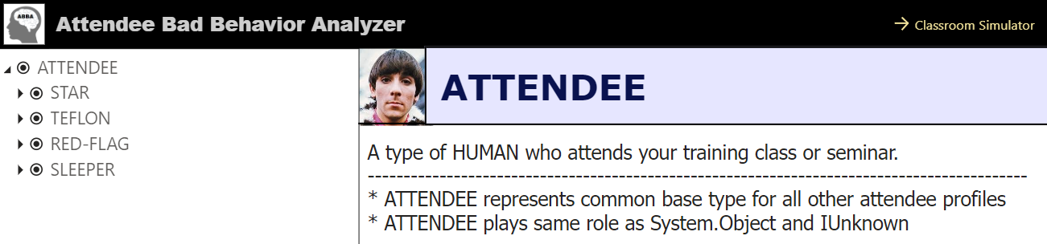
Attendee Profile Analysis
What are the benefits of profiling human behavior?
We see huge benefits to profiling serial killers and terrorists
Why not use behavioral profiling on attendees of your training class or seminar
We started our project by researching the art of behavioral profiling
We collaborated with Sweden’s 4 most renown behavioral psychologists
The result is a Power BI report at https://powerhour.azurewebsizes.net or https://aka.ms/abba
Dr Lyngstad
Dr Andersson
Dr Ulvaeus
Dr Fältskog

Slide 2
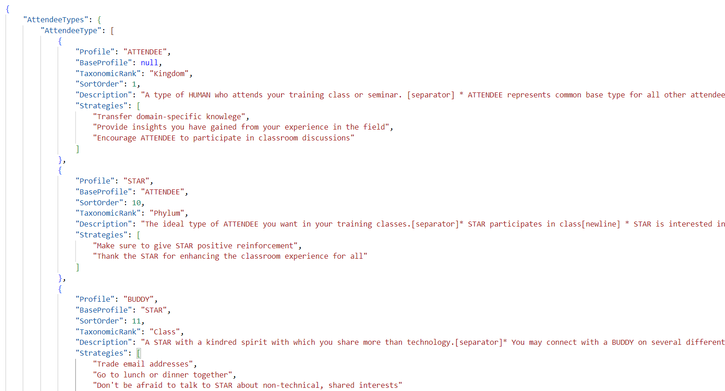
Project data stored in profiles.json
Pointer to base profile
Pointer to base profile

Slide 3
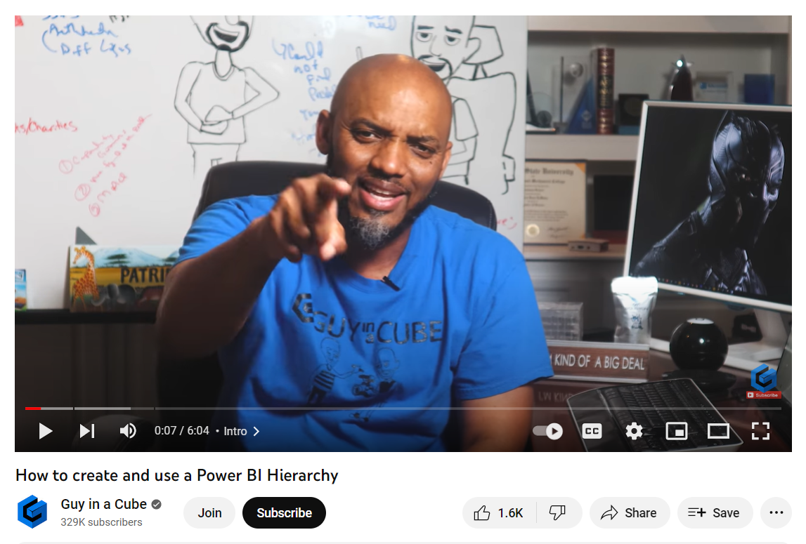
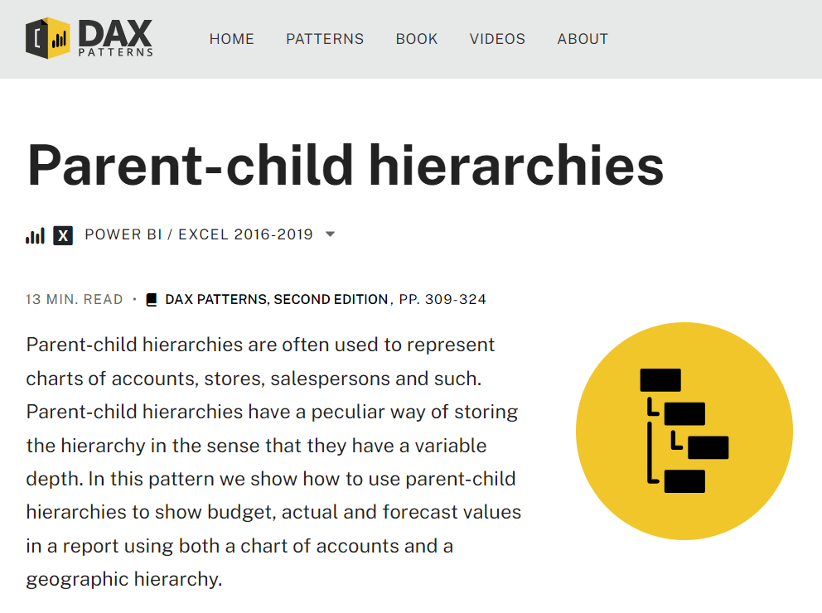
Learning About Hierarchies in Power BI

Slide 4
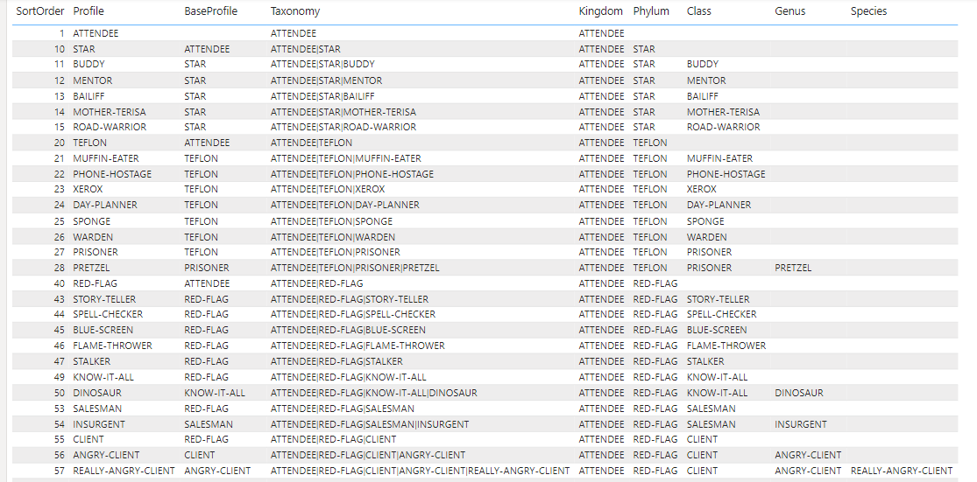

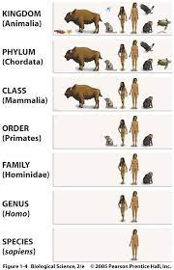
Implementing a Jagged Hierarchy in Power BI Desktop

Slide 5
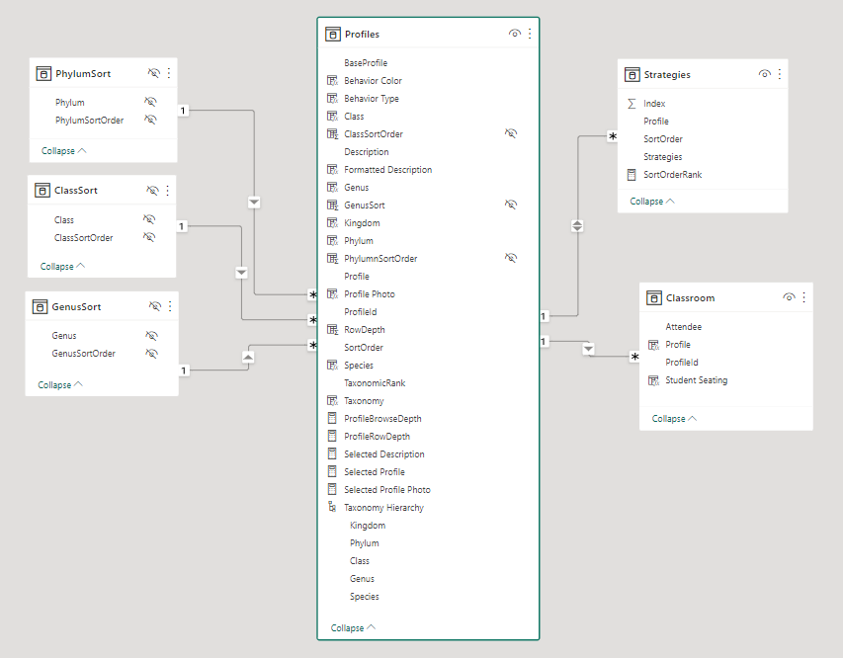
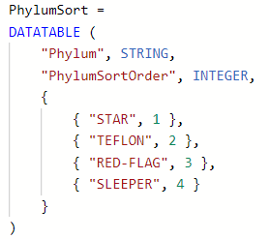
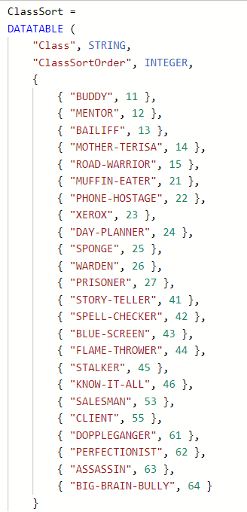
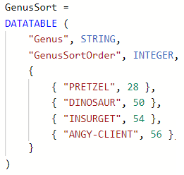
Sorting within Hierarchy Levels
Level 2 Sort
Level 3 Sort
Level 4 Sort

Slide 6
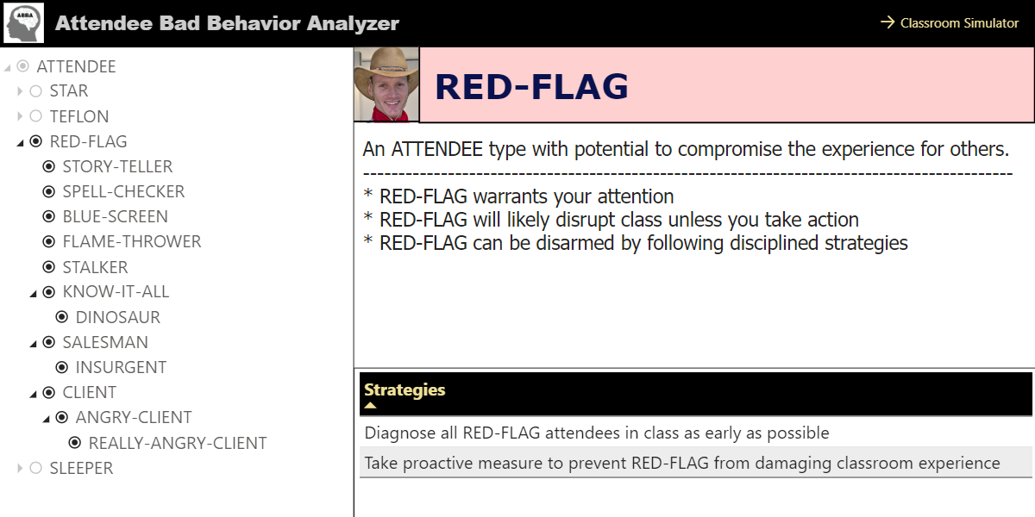
RED-FLAG Attendees

Slide 7
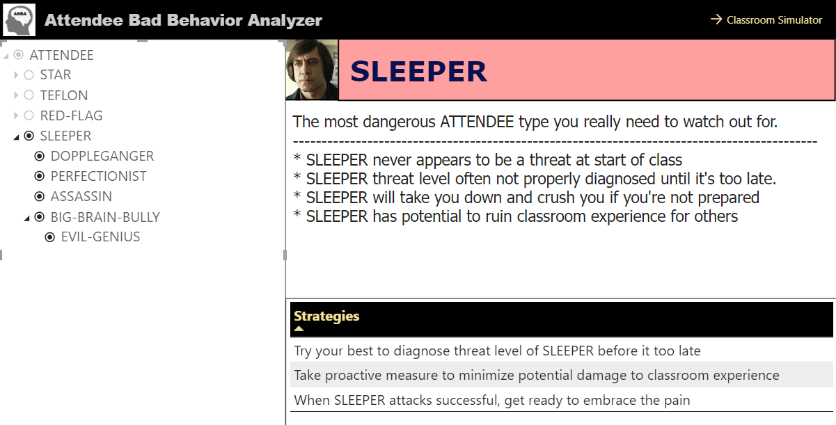
SLEEPER Attendees – Watch Out!

Slide 8
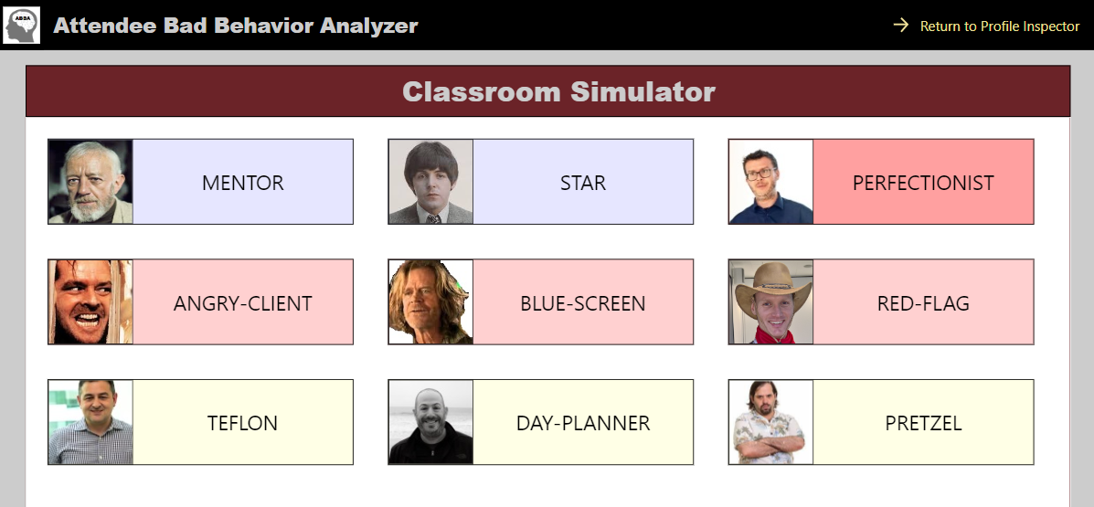
Classroom Simulator
Like a flight simulator for pilots in training
Uses DAX to randomly choose class size and types of attendee

Slide 9
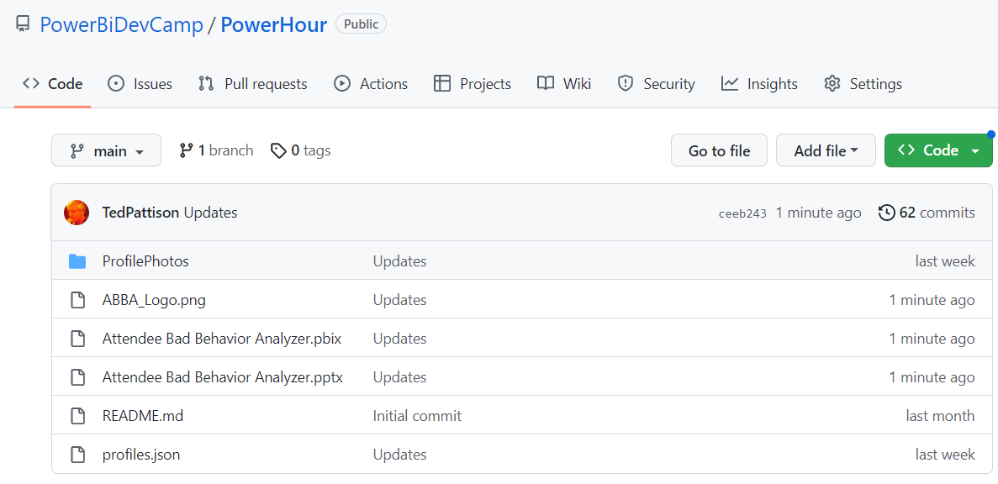
Download the sample code from GitHub
https://github.com/PowerBiDevCamp/PowerHour

